Slide 1

Data analysis report
Findings on behavioral differences between casual riders and member riders
Presented by: Abraham Cedeño
Date: October 12, 2022

Slide 2
Table of contents
Data analysis report
Business task
Data available
Findings
Recommendations

Slide 3
Business task

Slide 4
Business task
The objective of this project is to study the historical bike trip data of the different types of Cyclistic clients (casual and members) over the last 12 months to understand how they use Cyclistic bikes differently.
The findings of this project are going to help the marketing team determine which digital media strategy to pursue so that they can influence casual riders to opt-in for an annual membership.

Slide 5
Data available

Slide 6
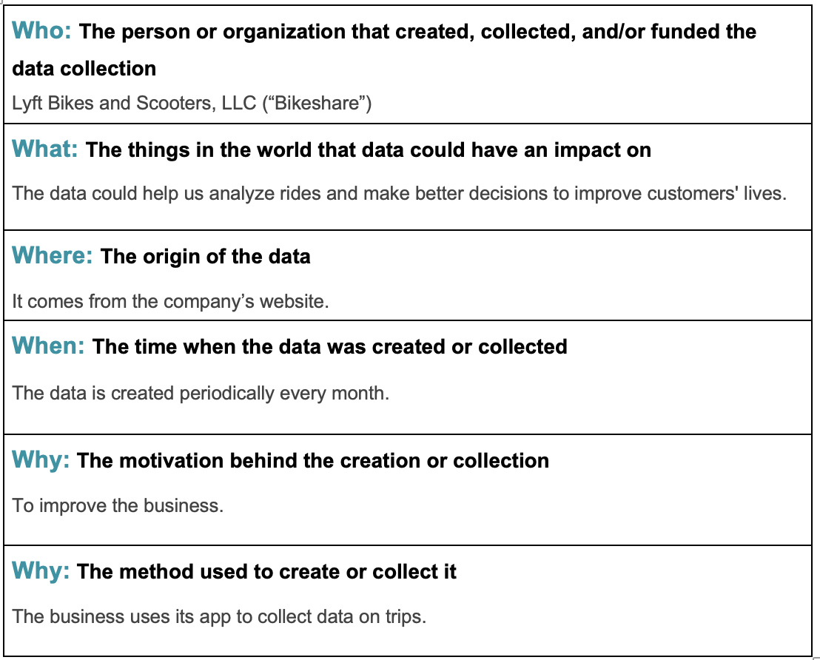
Data context

Slide 7
Data properties
Each trip is anonymized and includes:
*Ride id
*Rideable type (classic bike, electric bike, docked bike)
*Trip start day and time
*Trip end day and time
*Trip start station id
*Trip start station name
*Trip end station id
*Trip end station name
*Start latitude
*Start longitude
*End latitude
*End longitude
*Rider type (Member, Single Ride, and Day Pass)

Slide 8
Findings

Slide 9
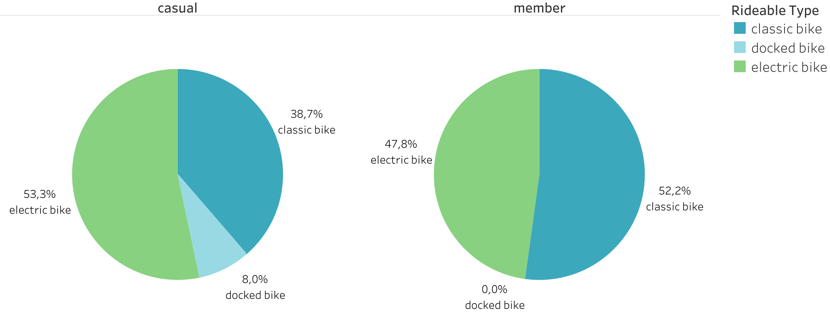
Bike Selection Comparison between Casual and Member Riders
The preferred bikes among members are roughly 50/50.
Electric bikes are more commonly preferred by casual riders than classic bikes.
While none of the member riders use docked bikes, several casual riders do.

Slide 10
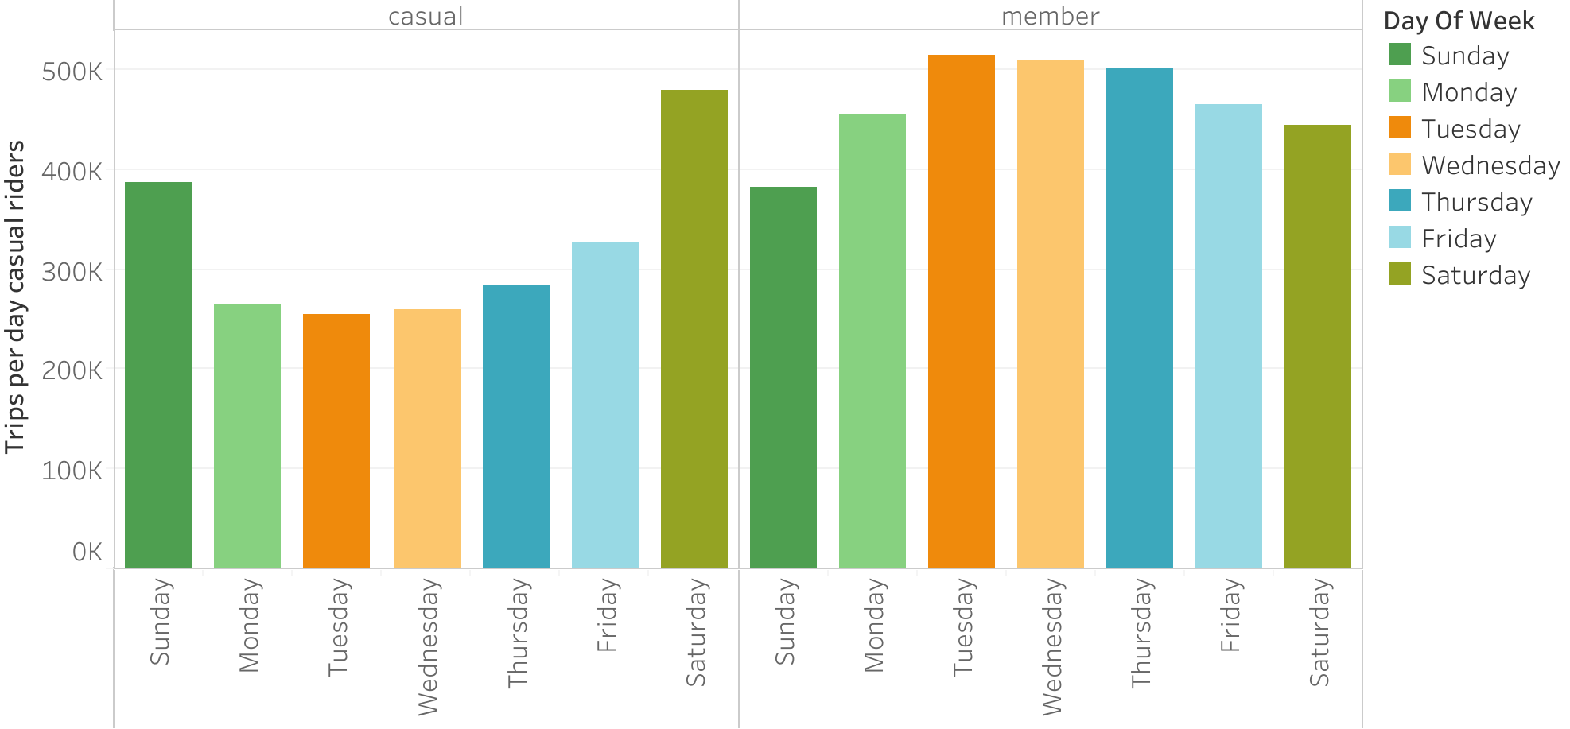
Daily Trip Pattern Comparison between Casual and Member Riders
Casual rider use our service on weekends more often.
The opposite pattern may be note with member riders which use our services more frequently on weekdays.

Slide 11
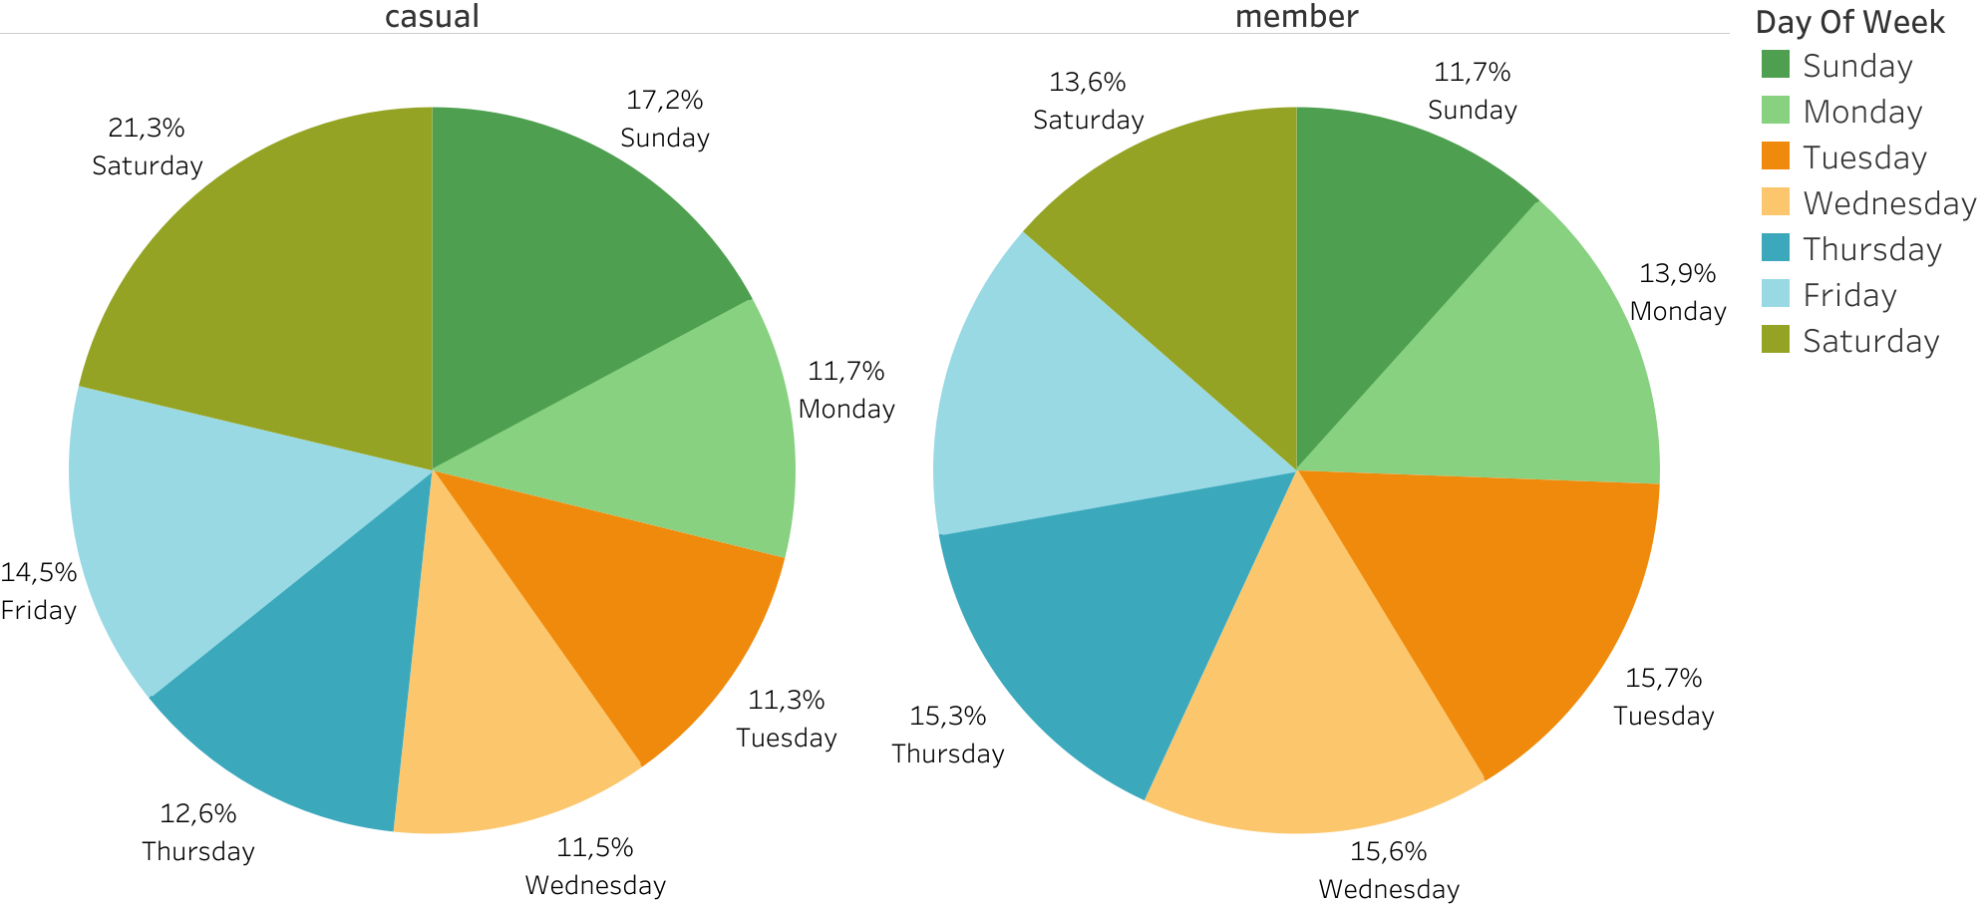
Daily Trip Pattern Comparison between Casual and Member Riders
Casual rider use our service on weekends more often.
The opposite pattern may be note with member riders which use our services more frequently on weekdays.

Slide 12
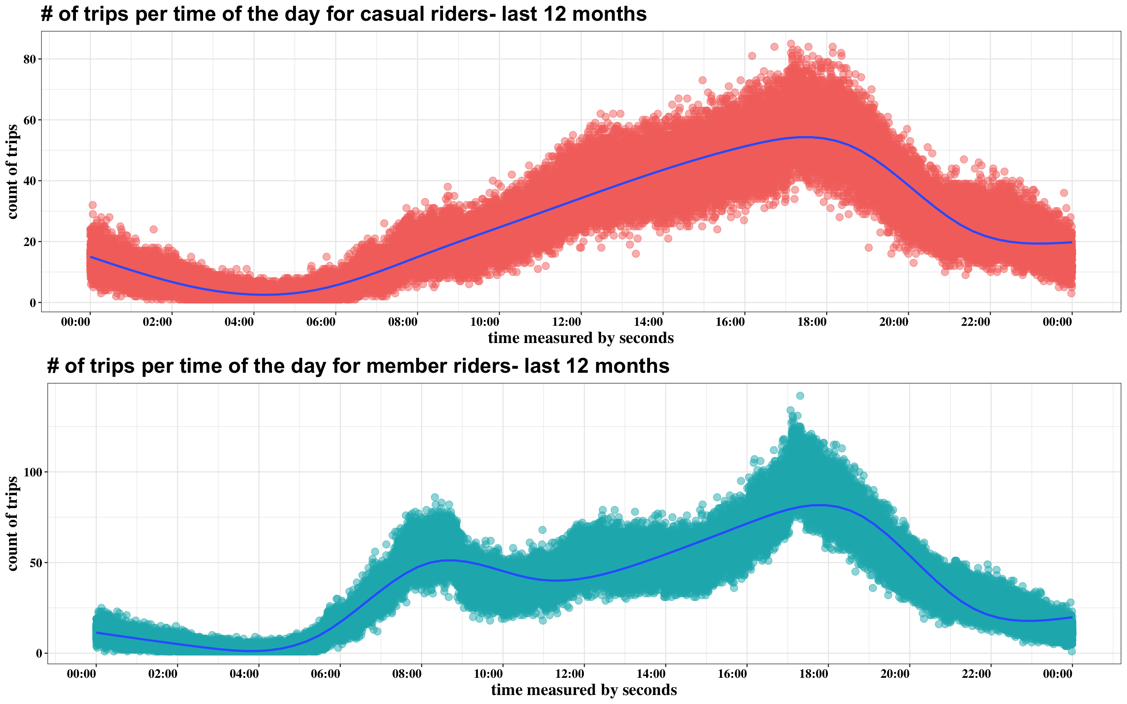
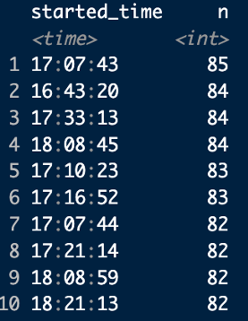
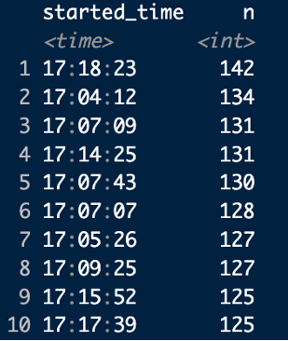
Timeline of Trip Departures: Second by Second
The peak of departures for both categories of riders occurs at approximately 5:10 PM.
Behavior patterns vary throughout the day. Member riders have an initial peak departure at 8:30 AM, declining until 4:00 PM when it rises again. Casual riders have continuously increased departures.

Slide 13
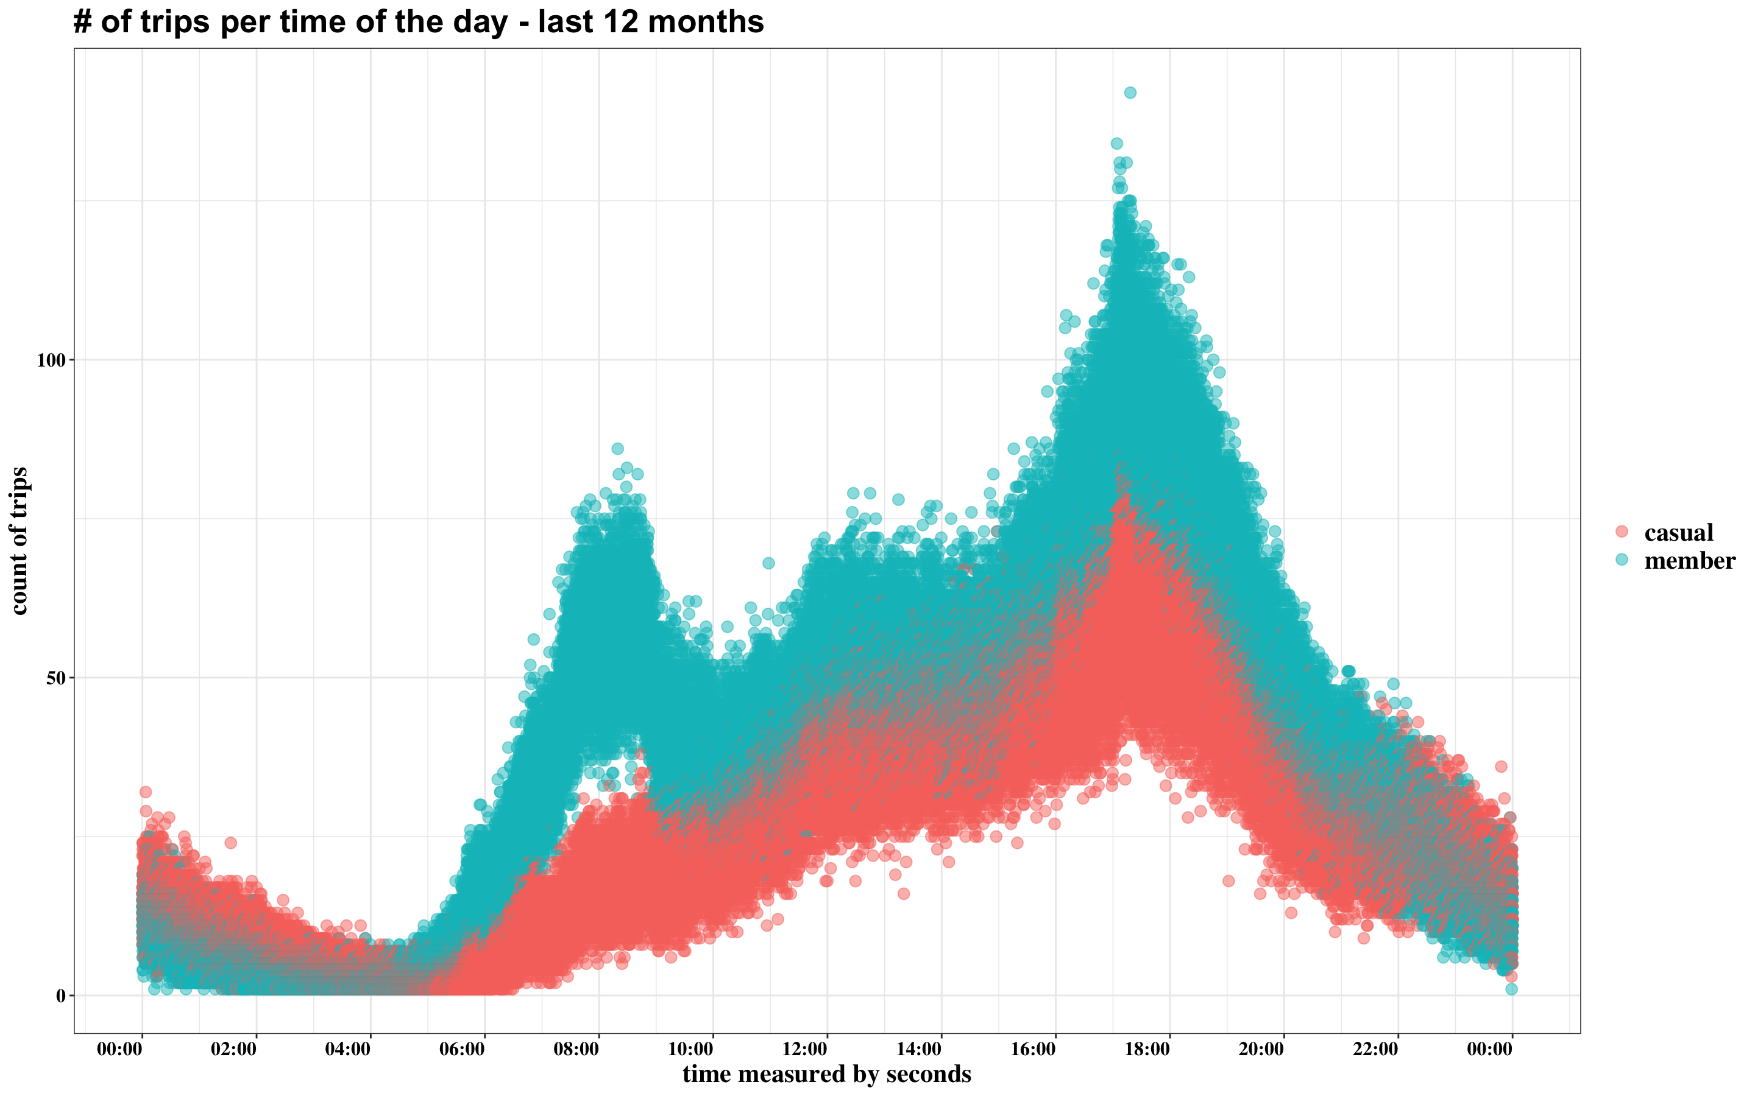
Timeline of Trip Departures: Second by Second
The peak of departures for both categories of riders occurs at approximately 5:10 PM.
Behavior patterns vary throughout the day. Member riders have an initial peak departure at 8:30 AM, declining until 4:00 PM when it rises again. Casual riders have continuously increased departures.

Slide 14
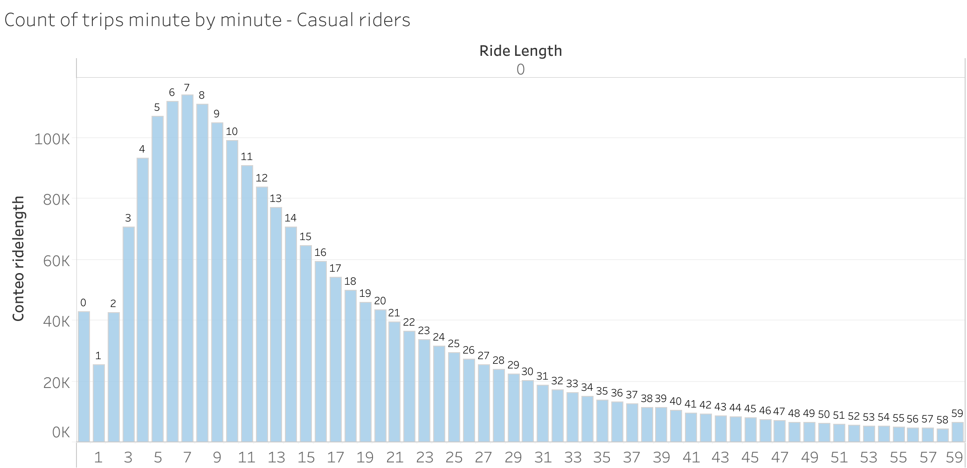
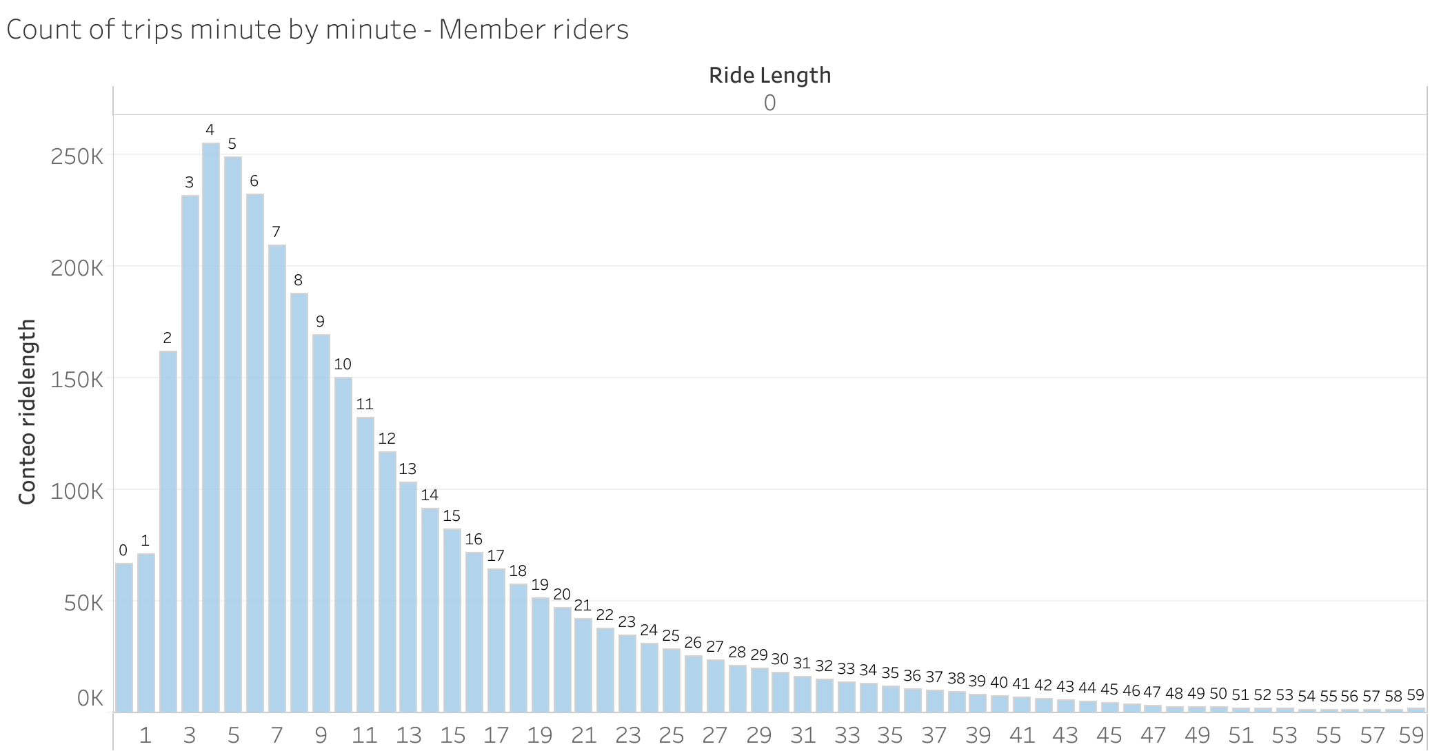
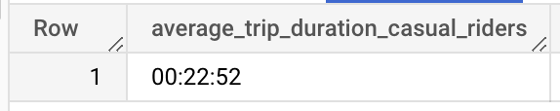
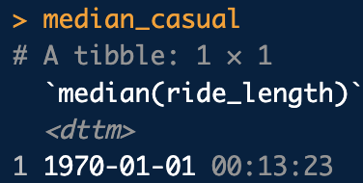
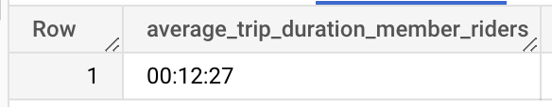
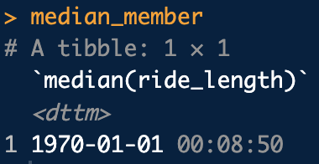
Ride Length Distribution among Both Types of Riders
The average ride length for casual riders exceeds that of member riders.
The median difference between the two is approximately 5 minutes.

Slide 15
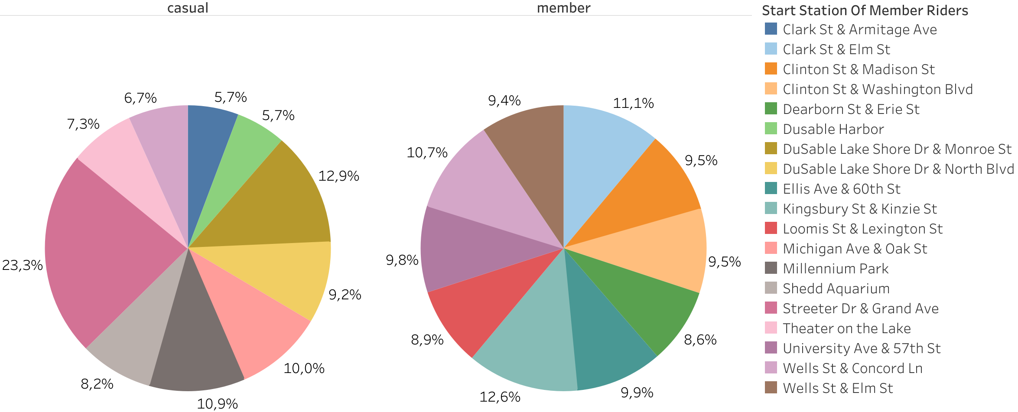
Preferred Starting Station Comparison between Casual and Member Riders
Significant Preference Observed Among Casual Riders for the 'Streeter DR & Grand Ave' Station as Starting Point (more than 1 in 5 customers start there).
Approximately Equal Distribution of Preferred Starting Stations Observed Among Member Riders.

Slide 16
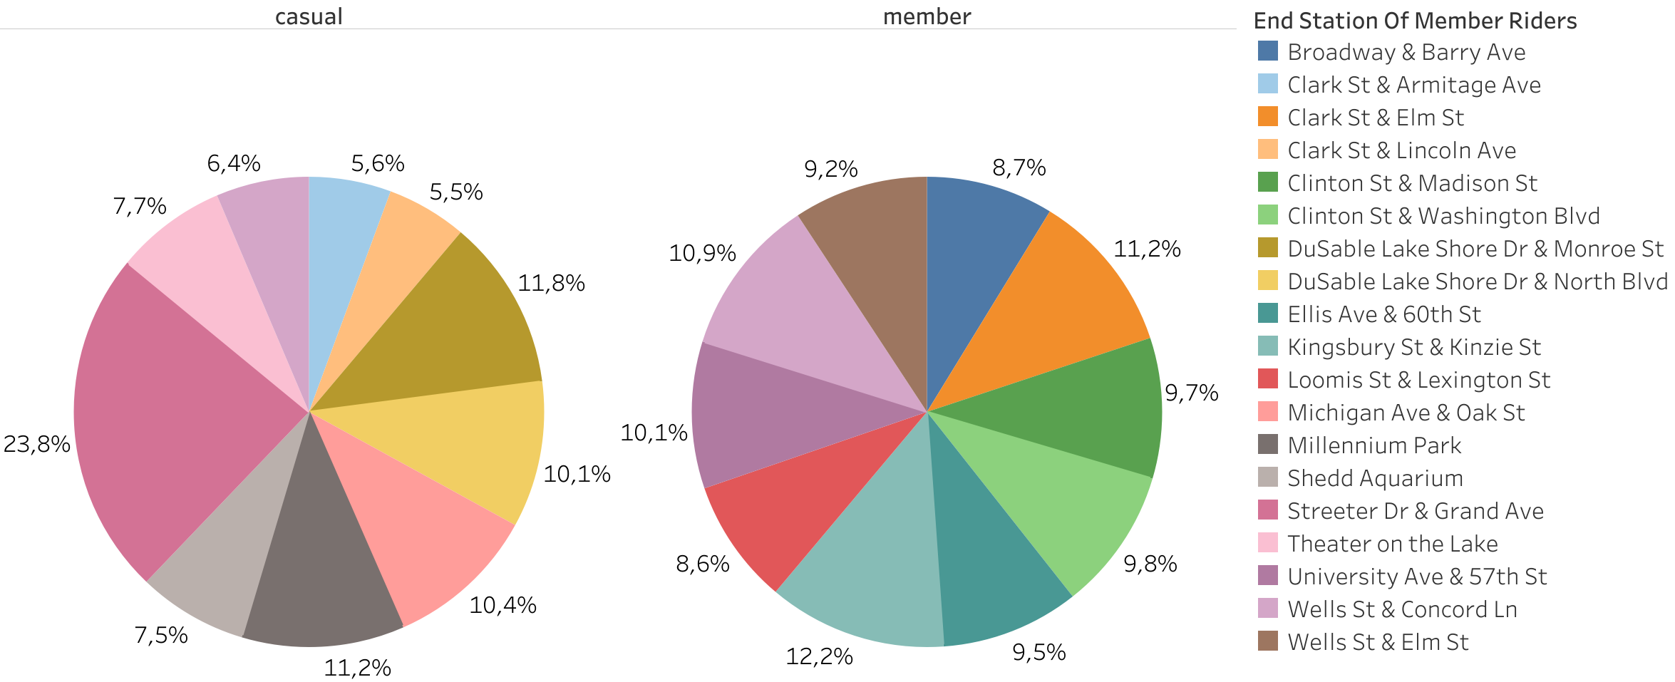
Preferred Ending Station Comparison between Casual and Member Riders
Again, a significant preference observed among casual riders for the 'Streeter DR & Grand Ave' Station as ending point (more than 1 in 5 customers end there).
Approximately equal distribution of preferred starting stations observed among member riders.

Slide 17
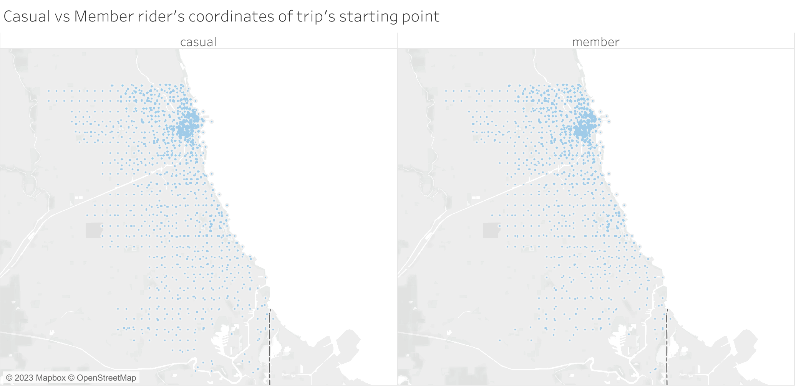
Starting Point Distribution among Both Types of Riders
Limited Difference in trip starting point distribution observed between casual and member riders.
High concentration of service utilization observed in a specific area.
Same pattern was found with the ending point.

Slide 18
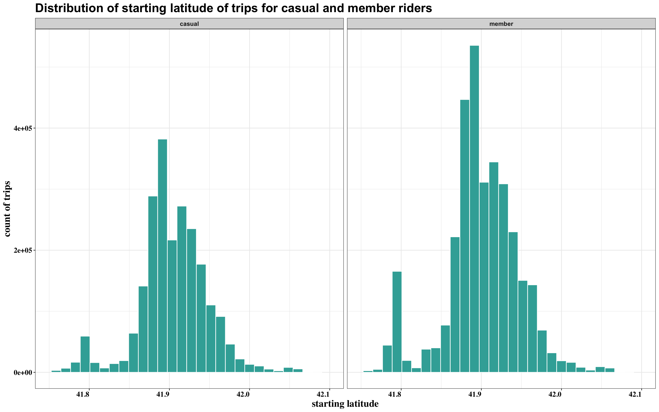
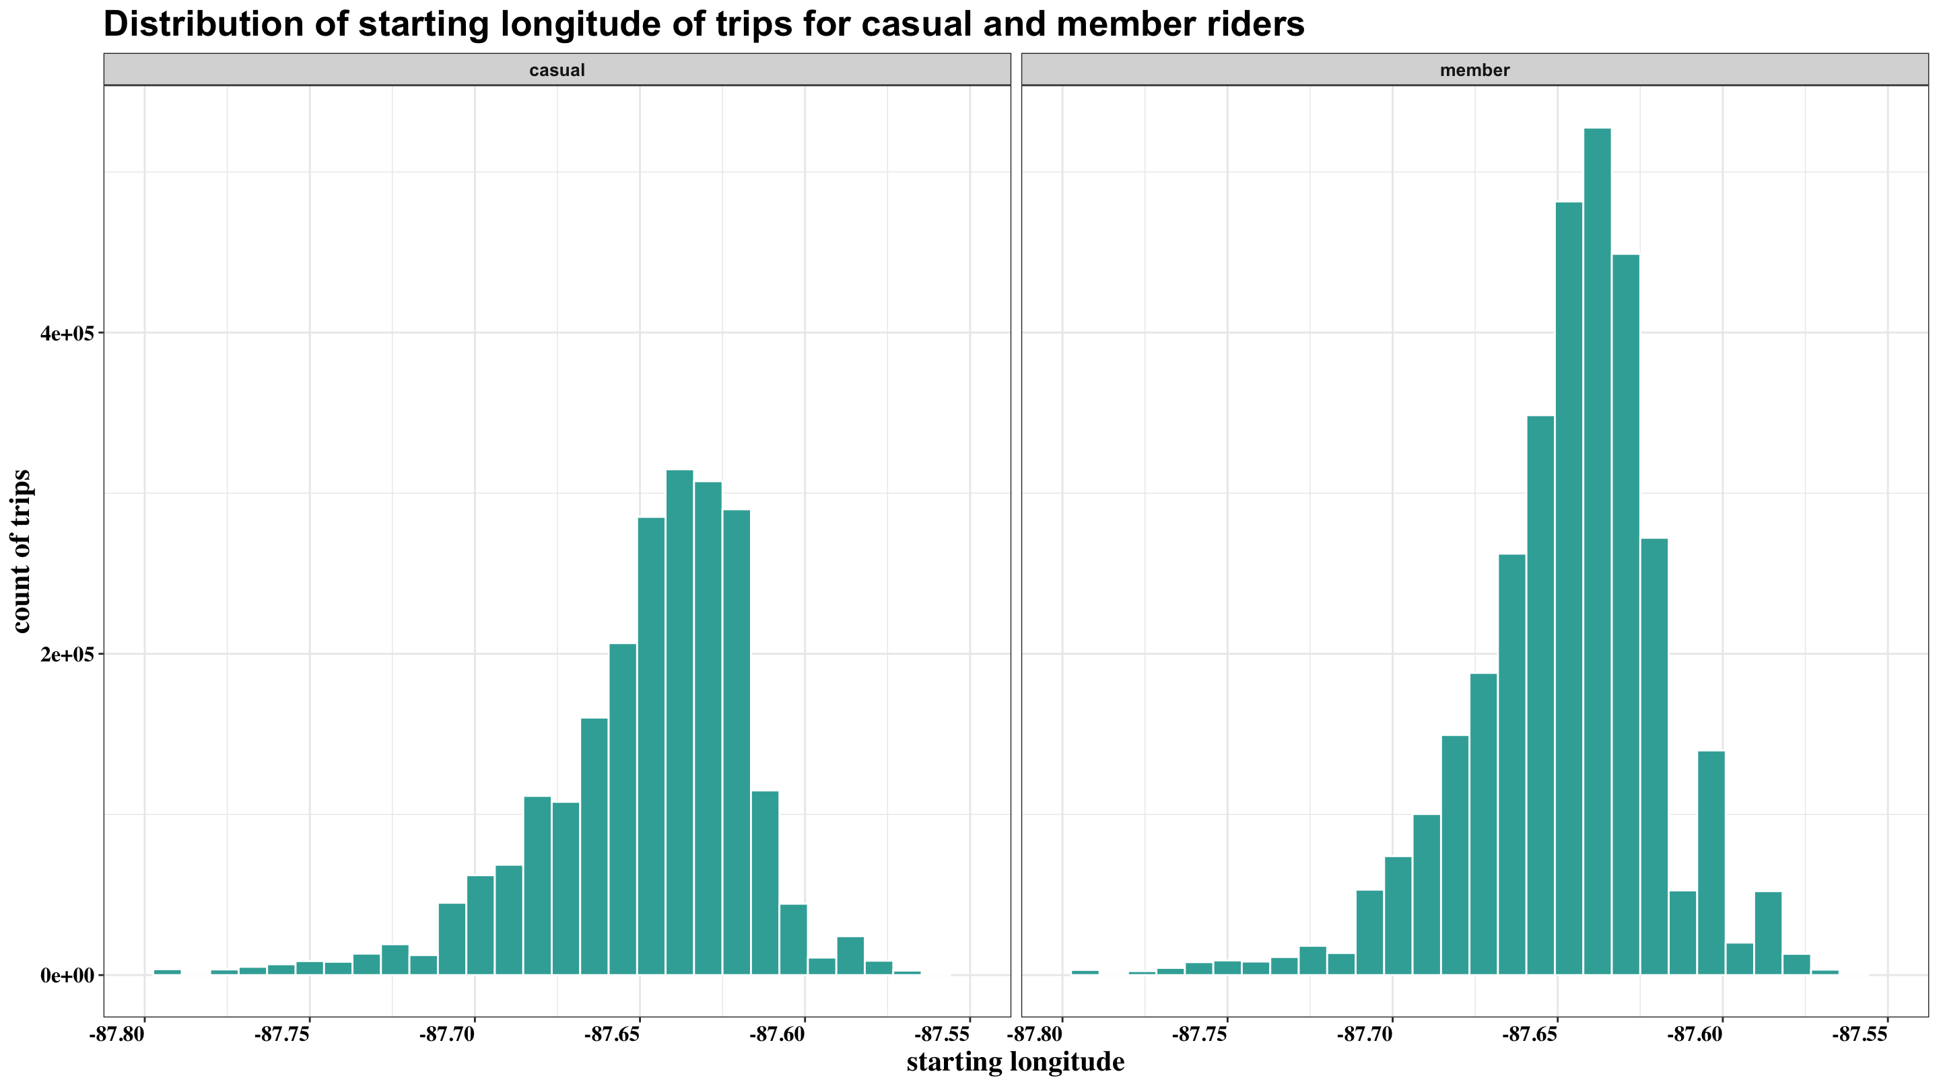
Starting Point Distribution among Both Types of Riders
Limited Difference in trip starting point distribution observed between casual and member riders.
High concentration of service utilization observed in a specific area.
Same pattern was found with the ending point.

Slide 19
Recommendations

Slide 20
Recommendations
1
2
3
Emphasize Electric Bikes:
Based on our analysis, casual riders have a preference for electric bikes. It is recommended to increase marketing efforts to promote this type of bike.
Maintain Focus on Docked Bikes:
Despite the lower demand, it is still important to continue promoting docked bikes as several of our casual riders use them too.
Weekend Focus for Casual Riders:
Casual riders use our service more often on weekends.
It is recommended to adjust ad budget accordingly for greater cost-effectiveness during these days.
Time-based Ad Budgeting:
Aligning ad budget weight with trip departure timeline could increase effectiveness.
Peak Hour Reminder:
With peak usage around 5:10 PM, sending app notifications at this time could improve awareness and usage of our service.

Slide 21
Recommendations
4
5
6
Emphasize Cost-Savings for Casual Riders:
With longer trip duration for casual riders, promoting the cost-saving benefits of an annual membership can encourage subscription.
Targeted Campaigns Based on Trip Duration:
Using trip duration data, develop targeted campaigns to promote our services to specific groups of users."
Focus on 'Streeter DR & Grand Ave' Station:
As this station is preferred among casual riders, targeting advertising efforts to this location can increase effectiveness.
Target High-Usage Areas:
By focusing campaigns on areas with high concentrations of usage, as identified by latitude and longitude data, marketing efforts can be more impactful.

Slide 22
1
2
3
Emphasize Electric Bikes:
Based on our analysis, casual riders have a preference for electric bikes. It is recommended to increase marketing efforts to promote this type of bike.
Maintain Focus on Docked Bikes:
Despite the lower demand, it is still important to continue promoting docked bikes as several of our casual riders use them too.
Weekend Focus for Casual Riders:
Casual riders use our service more often on weekends.
It is recommended to adjust ad budget accordingly for greater cost-effectiveness during these days.
Time-based Ad Budgeting:
Aligning ad budget weight with trip departure timeline could increase effectiveness.
Peak Hour Reminder:
With peak usage around 5:10 PM, sending app notifications at this time could improve awareness and usage of our service.

Slide 23
4
5
6
Emphasize Cost-Savings for Casual Riders:
With longer trip duration for casual riders, promoting the cost-saving benefits of an annual membership can encourage subscription.
Targeted Campaigns Based on Trip Duration:
Using trip duration data, develop targeted campaigns to promote our services to specific groups of users."
Focus on 'Streeter DR & Grand Ave' Station:
As this station is preferred among casual riders, targeting advertising efforts to this location can increase effectiveness.
Target High-Usage Areas:
By focusing campaigns on areas with high concentrations of usage, as identified by latitude and longitude data, marketing efforts can be more impactful.

Slide 24
Thank you

